Slide 1





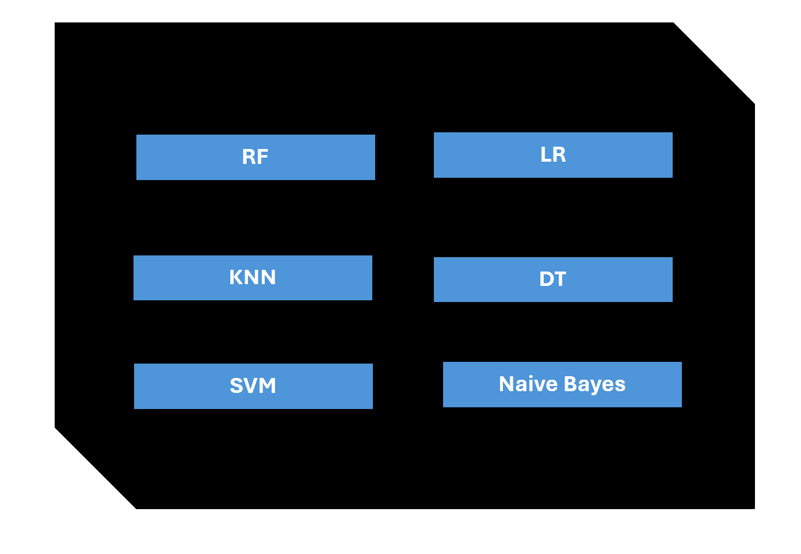
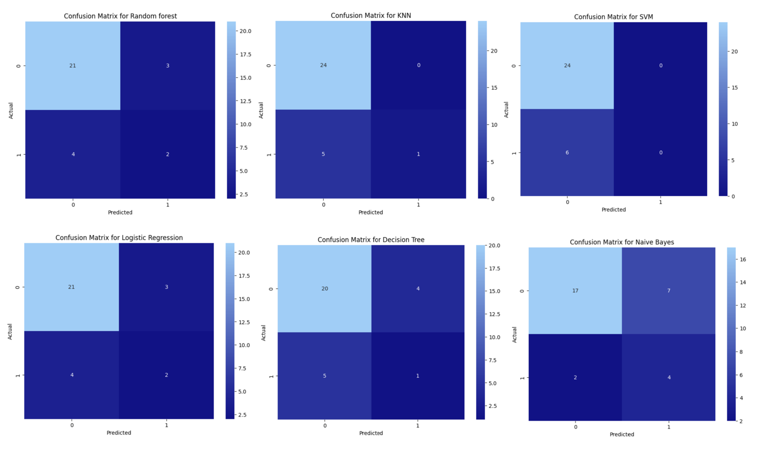
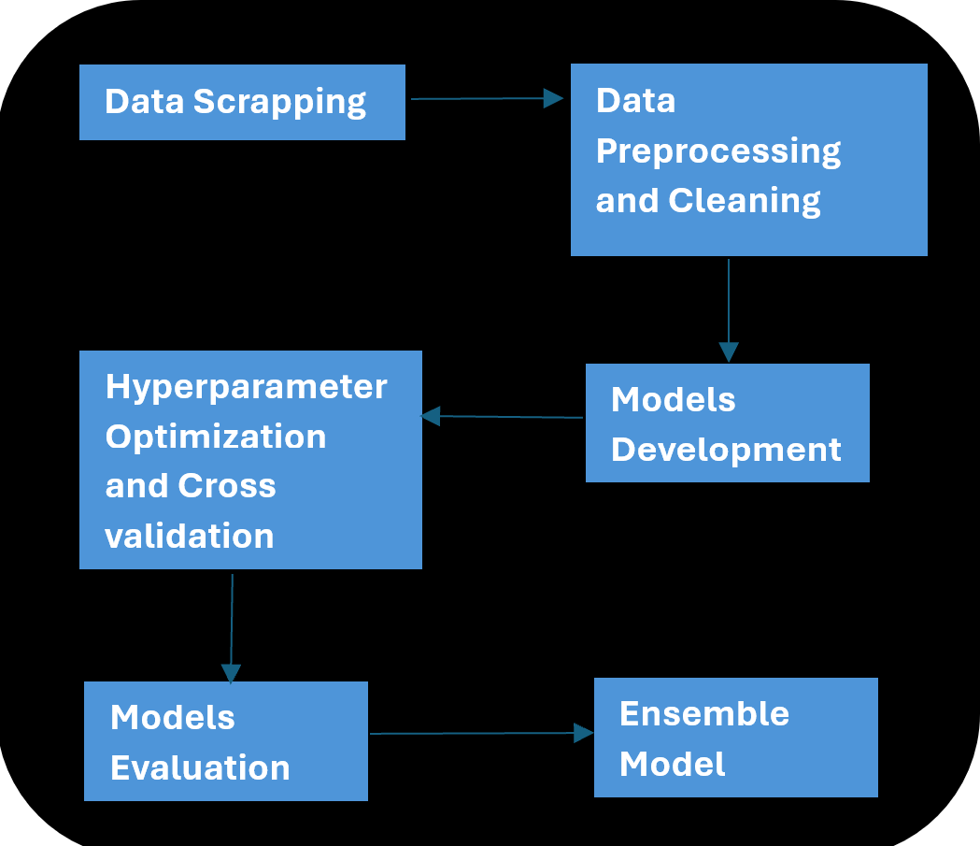


CSCI417-04
CSCI 221
Arithmetic Logic Unit
RespectNet: Detect offensive language
ABSTRACT
INTRODUCTION
This project aims to develop a machine learning model for the detection of offensive language. The objective is to create an automated system capable of accurately identifying and classifying harmful content in text. The project involves data scrapping and collection, preprocessing, feature extraction, and the exploration of various machine learning algorithms. Performance evaluation metrics are utilized to assess the effectiveness of the models. The developed model demonstrates promising results and can be applied in content moderation systems and social media platforms to identify and address offensive language. This project contributes to the ongoing efforts to foster a safer and more respectful online environment.
.
This project focuses on developing a machine learning model to detect offensive language. By collecting , scrapping, and preprocessing relevant data, extracting meaningful features, and exploring various machine learning algorithms, we aim to create an automated system capable of accurately identifying and categorizing harmful content in text. The performance of the model will be evaluated using appropriate metrics, and its potential application in content moderation systems and social media platforms will be examined. This project aims to contribute to ongoing efforts in fostering a safer and more respectful online environment by addressing the urgent need for effective tools to combat the proliferation of offensive language.
Methodology
RESULTS
In our machine learning project to predict offensive language, we obtained our data from Scrapping Twitter. After collecting the data, we cleaned and prepared it by removing irrelevant information, handling missing values. Then we chose six machine learning models (KNN, logistic regression, naive Bayes, decision trees , SVM and random forest) and adjusted their settings using a technique called grid search to find the best set of hyperparameters for our models and cross validated them. Finally, the data was modeled, we chose algorithms of supervised learning, data was 70%-30% split and we vectorized the data. The models were implemented. A confusion matrix was created to summarize the performances of the models, classification report to provide us with detailed summary of important metrics such as precision, recall, F1-score, and support for each class in the classification problem, and finally, ensemble
The results were: 86.66% , 83.33% , 80% ,80 %, 76.66% , 70% , 70% for RF, KNN, SVM, LR , DT , Naïve Bayes. respectively, rounded to 2 decimal places. RF came out to be the most accurate model of the six models
Conclusion
In conclusion, this project has successfully developed a machine learning model for the detection of offensive language in text. The automated system demonstrates promising results, accurately identifying and classifying harmful content. By integrating this model into content moderation systems and social media platforms, we can proactively address instances of offensive language, fostering a safer and more respectful online environment. The outcomes of this project contribute to the ongoing efforts of creating a digital space that promotes inclusivity, tolerance, and constructive dialogue.
TEAM MEMBERS
DONE BY:
Shahd Ayman Abdullah
Rawan Ayman Saied
Merna Mohamed Salem
Trevena Ayman
Farah Amr Mohamed
Moura Saber Ayoub

